Slide 1
Deep Learning Models for Network Anomaly Detection
Comparing Multi-SSN, Bi-LSTM + GRU, CNN + LSTM, and Self-Supervised Learning
BATCH-57
Guide :
ROLL NUMBERS
22881A66E3
22881A66E6
22881A66H0
Dr.M.A. Jabbar
(hod)-csm

Slide 2
Multi-SSN (CAE + GRU + BL) Model
Uses Convolutional Autoencoder (CAE) for feature extraction
Gated Recurrent Unit (GRU) for sequential learning
Bayesian Learning (BL) for classification
Optimized using Predefined-Mud Ring Algorithm (P-MRA)
Effective for anomaly detection in IoT and SDN networks

Slide 3
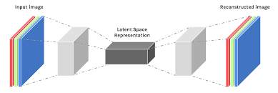
Convolutional Autoencoder (CAE)

Slide 4
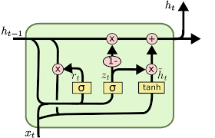
Gated Recurrent Unit (GRU)

Slide 5
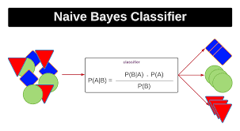
Bayesian Learning

Slide 6
Bi-LSTM + GRU – Best Alternative Model
Bi-LSTM captures forward and backward sequential dependencies
GRU optimizes memory usage and speeds up training
More efficient than Multi-SSN with similar accuracy
Works well for real-time intrusion detection systems
Reduces false positives and improves detection accuracy

Slide 7
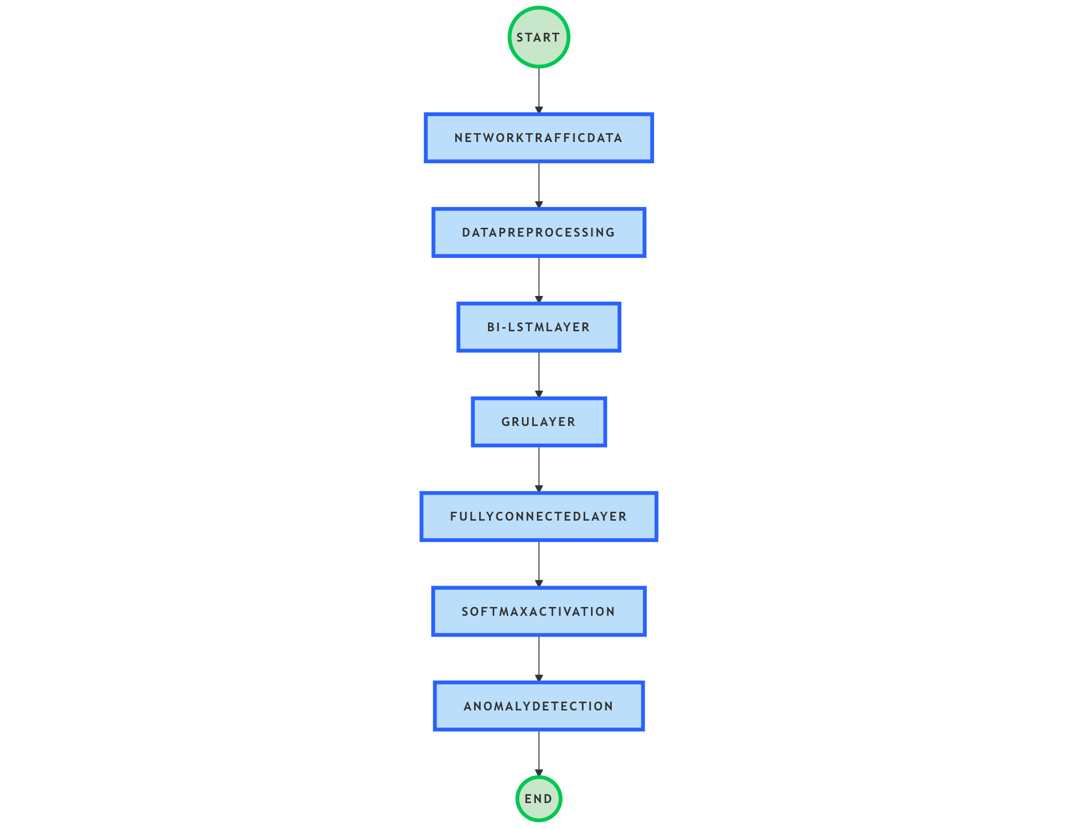
FLOWCHART

Slide 8
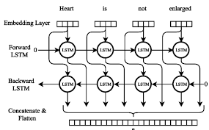
Bi-LSTM

Slide 9
Gated Recurrent Unit (GRU)

Slide 10
CNN + LSTM – Hybrid Alternative
CNN extracts spatial features from network traffic data
LSTM captures temporal dependencies over time
Effective for packet-level anomaly detection
Useful for analyzing high-dimensional network data
Higher memory usage but strong feature extraction capabilities

Slide 11
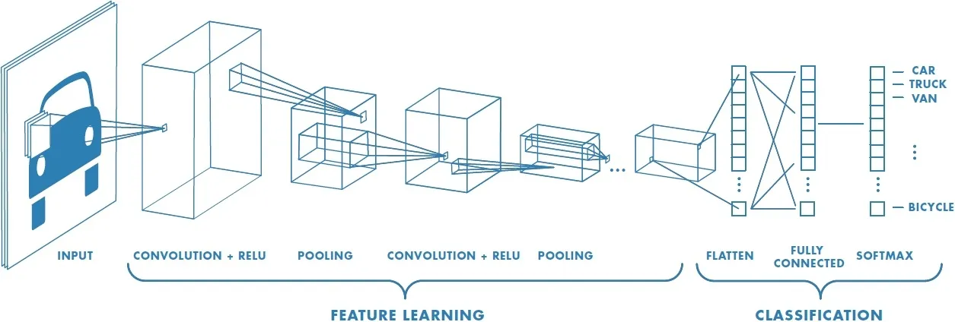
CNN

Slide 12
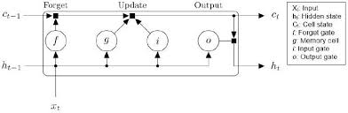
LSTM

Slide 13
Self-Supervised Learning (Transformer-based Anomaly Detection)
Learns from unlabeled network traffic data
Uses Transformer models (similar to BERT) for feature learning
No need for labeled attack data – detects zero-day threats
Scalable for large datasets and cloud security applications
Computationally expensive but highly adaptable

Slide 14
Comparison Table of Models
1. Multi-SSN: Best for IoT & SDN, high accuracy, but complex
2. Bi-LSTM + GRU: Best for real-time detection, faster than Multi-SSN
3. CNN + LSTM: Best for signature-based detection, requires more memory
4. Self-Supervised Learning: Best for zero-day attack detection, no labeled data needed

Slide 15
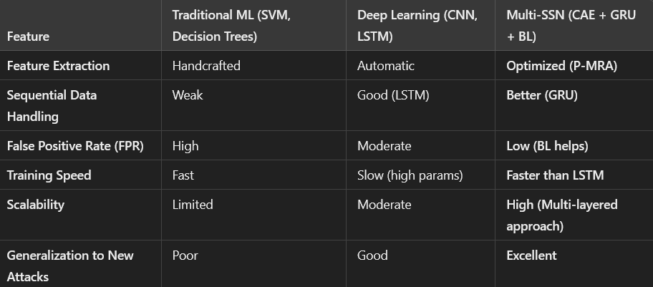
Comparison with Traditional Models

Slide 16
THE END

